Slide 1
Cloud Computing
Module-5

Slide 2
Parallel Computing and Programming Paradigms
Partitioning This is applicable to both computation and data as follows:
Computation partitioning This splits a given job or a program into smaller tasks. Partitioning greatly depends on correctly identifying portions of the job or program that can be performed concurrently.
Data partitioning This splits the input or intermediate data into smaller pieces. Similarly, upon identification of parallelism in the input data, it can also be divided into pieces to be processed on different workers.
Mapping This assigns the either smaller parts of a program or the smaller pieces of data to underlying resources. This process aims to appropriately assign such parts or pieces to be run simultaneously on different workers and is usually handled by resource allocators in the system.

Slide 3
Synchronization Because different workers may perform different tasks, synchronization and coordination among workers is necessary so that race conditions are prevented and data dependency among different workers is properly managed..
Communication Because data dependency is one of the main reasons for communication among workers, communication is always triggered when the intermediate data is sent to workers.
Scheduling For a job or program, when the number of computation parts (tasks) or data pieces is more than the number of available workers, a scheduler selects a sequence of tasks or data pieces to be assigned to the workers.

Slide 4
Motivations behind parallel and distributed programming models are
(1) to improve productivity of programmers,
(2) to decrease programs’ time to market,
(3) to leverage underlying resources more efficiently,
(4) to increase system throughput,
(5) to support higher levels of abstraction
MapReduce, Hadoop, and Dryad are three of the most recently proposed parallel and distributed programming models

Slide 5
MapReduce
MapReduce, is a software framework which supports parallel and distributed computing on large data sets.
This software framework abstracts the data flow of running a parallel program on a distributed computing system by providing users with two interfaces in the form of two functions: Map and Reduce.
Users can override these two functions to interact with and manipulate the data flow of running their programs.

Slide 6
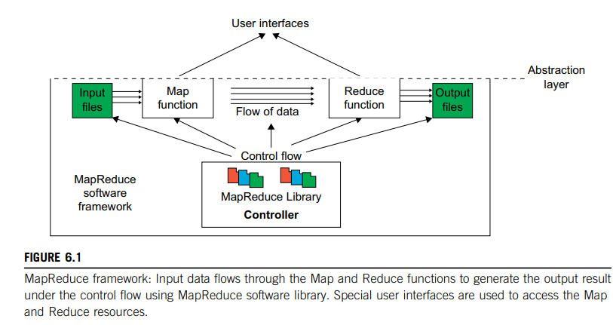

Slide 7
The input data to the Map function is in the form of a (key, value) pair
The output data from the Map function is structured as (key, value) pairs called intermediate (key, value) pairs.
The user-defined Map function processes each input (key, value) pair and produces a number of (zero, one, or more) intermediate (key, value) pairs. Here, the goal is to process all input (key, value) pairs to the Map function in parallel
The Reduce function receives the intermediate (key, value) pairs in the form of a group of intermediate values associated with one intermediate key, (key, [set of values]).
MapReduce framework forms these groups by first sorting the intermediate (key, value) pairs and then grouping values with the same key.
It should be noted that the data is sorted to simplify the grouping process. The Reduce function processes each (key, [set of values]) group and produces a set of (key, value) pairs as output.

Slide 8
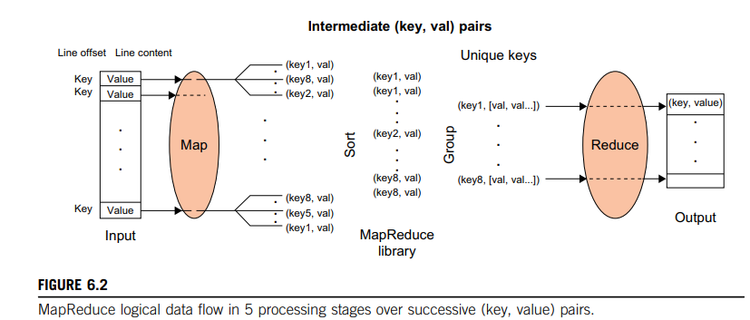

Slide 9
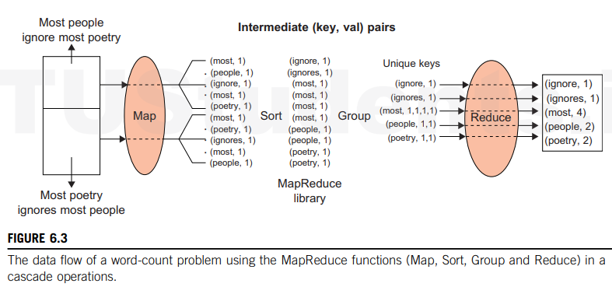

Slide 10
MapReduce Actual Data and Control Flow
Data partitioning :The MapReduce library splits the input data (files), already stored in GFS, into M pieces that also correspond to the number of map tasks.
Computation partitioning This is implicitly handled (in the MapReduce framework) by obliging users to write their programs in the form of the Map and Reduce functions. Therefore, the MapReduce library only generates copies of a user program (e.g., by a fork system call) containing the Map and the Reduce functions, distributes them, and starts them up on a number of available computation engines

Slide 11
Determining the master and workers The MapReduce architecture is based on a masterworker model. Therefore, one of the copies of the user program becomes the master and the rest become workers. The master picks idle workers, and assigns the map and reduce tasks to them.
Reading the input data (data distribution) Each map worker reads its corresponding portion of the input data, namely the input data split, and sends it to its Map function.
Map function Each Map function receives the input data split as a set of (key, value) pairs to process and produce the intermediated (key, value) pairs.

Slide 12
Combiner function This is an optional local function within the map worker which applies to intermediate (key, value) pairs. The user can invoke the Combiner function inside the user program. The Combiner function runs the same code written by users for the Reduce function as its functionality is identical to it.
Partitioning function:The intermediate (key, value) pairs produced by each map worker are partitioned into R regions, equal to the number of reduce tasks, by the Partitioning function to guarantee that all (key, value) pairs with identical keys are stored in the same region.
Synchronization MapReduce applies a simple synchronization policy to coordinate map workers with reduce workers, in which the communication between them starts when all map tasks finish.
Communication Reduce worker i, already notified of the location of region i of all map workers, uses a remote procedure call to read the data from the respective region of all map workers

Slide 13
Sorting and Grouping: The reduce worker groups intermediate (key, value) pairs by sorting the data based on their keys, followed by grouping all occurrences of identical keys.
Reduce function The reduce worker iterates over the grouped (key, value) pairs, and for each unique key, it sends the key and corresponding values to the Reduce function.

Slide 14
Twister and Iterative MapReduce
Twister is a distributed in-memory MapReduce runtime optimized for iterative MapReduce computations. It reads data from local disks of the worker nodes and handles the intermediate data in distributed memory of the worker nodes. All communication and data transfers are performed via a publish/subscribe messaging infrastructure.
Twister architecture comprises of three main entities; (i) client side driver (Twister Driver) that drives the entire MapReduce computation, (ii) Twister Daemon running on every worker node, and (iii) the broker network.
During the initialization of the runtime, Twister starts a daemon process in each worker node, which then establishes a connection with the broker network to receive commands and data.
The daemon is responsible for managing map/reduce tasks assigned to it, maintaining a worker pool to execute map and reduce tasks, notifying status, and finally responding to control events.
The client side driver provides the programming API to the user and converts these Twister API calls to control commands and input data messages sent to the daemons running on worker nodes via the broker network.

Slide 15
Twister uses a publish/subscribe messaging infrastructure to handle four types of communication needs; (i) sending/receiving control events, (ii) send data from the client side driver to the Twister daemons, (iii) intermediate data transfer between map and reduce tasks, and (iv) send the outputs of the reduce tasks back to the client side driver to invoke the combine operation

Slide 16
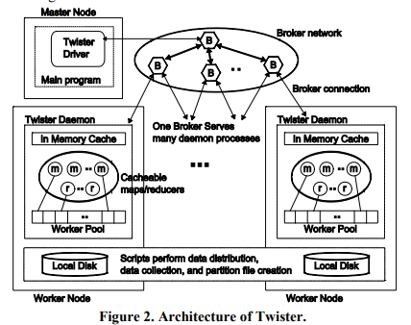

Slide 17
1. Master Node
Twister Driver: The master node contains the Twister Driver, which controls the overall execution of MapReduce jobs.
Main Program: The application or program that utilizes Twister is managed from the master node, where the driver orchestrates task scheduling and job coordination.
2. Broker Network
This part of the architecture is critical for communication between different nodes. It forms a publish-subscribe network, where the "brokers" handle message distribution among nodes.
Brokers (B): The brokers are responsible for connecting the master node to various worker nodes. They handle messaging (e.g., task distribution, status updates, etc.) across the system. One broker typically serves multiple daemon processes on the worker nodes.
Broker Connection: Brokers are connected in a distributed manner, ensuring that multiple nodes can communicate efficiently with the master.

Slide 18
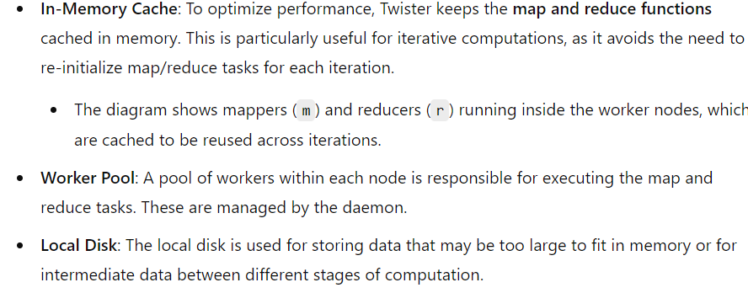
3. Worker Nodes
Each worker node runs multiple Twister Daemons and has its own in-memory cache and local disk. This is where the actual processing happens.

Slide 19
4. Twister Daemon
The Twister daemon runs on each worker node, handling the execution of map/reduce tasks and managing the in-memory cache.
It interacts with the broker network to receive tasks from the master node and exchange data with other worker nodes.
5. Scripts for Data Distribution
Scripts on the worker nodes handle data distribution, collection, and partition file creation. This means the tasks of breaking down the data into smaller chunks (partitions) and distributing it to the workers are automated.
They also handle the collection of results after each iteration or the final result after completing all iterations.

Slide 20
Hadoop Library from Apache
Hadoop is an open source implementation of MapReduce coded and released in Java (rather than C) by Apache.
The Hadoop implementation of MapReduce uses the Hadoop Distributed File System (HDFS) as its underlying layer rather than GFS.
The Hadoop core is divided into two fundamental layers: the MapReduce engine and HDFS.
The MapReduce engine is the computation engine running on top of HDFS as its data storage manager

Slide 21
HDFS Architecture
HDFS has a master/slave architecture containing a single NameNode as the master and a number of DataNodes as workers (slaves).
To store a file in this architecture, HDFS splits the file into fixed-size blocks (e.g., 64 MB) and stores them on workers (DataNodes).
The mapping of blocks to DataNodes is determined by the NameNode.
The NameNode (master) also manages the file system’s metadata and namespace.
In such systems, the namespace is the area maintaining the metadata, and metadata refers to all the information stored by a file system that is needed for overall management of all files.

Slide 22
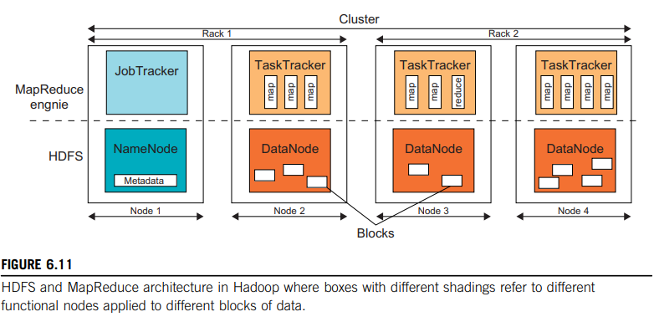

Slide 23
PigLatin
Pig Latin is a high-level data flow language developed by Yahoo! that has been implemented on top of Hadoop in the Apache Pig project.
Pig Latin is a highlevel data flow language used for processing large datasets in Hadoop. It provides a way to write complex data transformations using a series of commands that are similar to SQL but more flexible.
Pig Latin operations are performed in a sequence, similar to a data flow pipeline, which differs from SQL’s declarative nature. It supports user-defined functions as firstclass operations, allowing for more flexibility in data processing.

Slide 24
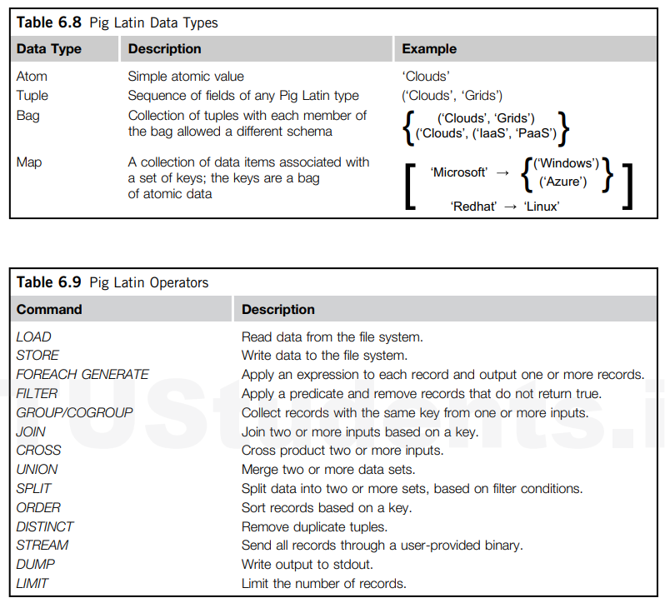

Slide 25
LOAD Command: This command loads data into a bag (a collection of tuples). The myUDF() is an example of a user-defined function that can be used to read data.
Queries = LOAD 'filewithdata.txt' USING myUDF() AS (userId, queryString, timestamp);
FOREACH Command: This command processes each tuple in the bag.
For example, Expanded_queries = FOREACH queries GENERATE userID, expandQueryUDF(queryString);
applies the expandQueryUDF function to each queryString.
FILTER Command: This command filters out tuples based on a condition.
For example, Real_queries = FILTER queries BY userID neq 'Alice’;
removes all tuples where userID is 'Alice’.
COGROUP Command: This command groups data from multiple bags based on a common field. For example, Grouped_data = COGROUP results BY queryString, revenue BY queryString;
groups the results and revenue bags by queryString.
Where results and revenue are bags of tuples (either from LOAD or processing of LOADed data) Results: queryString, url, position) Revenue: (queryString, adSlot, amount)
FLATTEN Command: This command is used to transform the result of a COGROUP into a flat structure similar to a SQL JOIN.

Slide 26
Programming on GAE
Programming for Google App Engine (GAE) involves building and deploying web applications on Google's infrastructure.
Languages: You can use languages like Python, Java, Go, and PHP.
Environment: GAE provides a fully managed environment, meaning Google handles the infrastructure, scaling, and load balancing.
Datastore: Use Google’s NoSQL Datastore for storing and querying data.
Memcache: Speed up your application with distributed memory caching.
Task Queues: Manage background tasks and asynchronous work.
Cron Jobs: Schedule tasks to run at specific times.
APIs: Access various Google services like Mail, URL Fetch, and more.
GAE simplifies the process of deploying and managing applications, allowing you to focus on writing code.

Slide 27
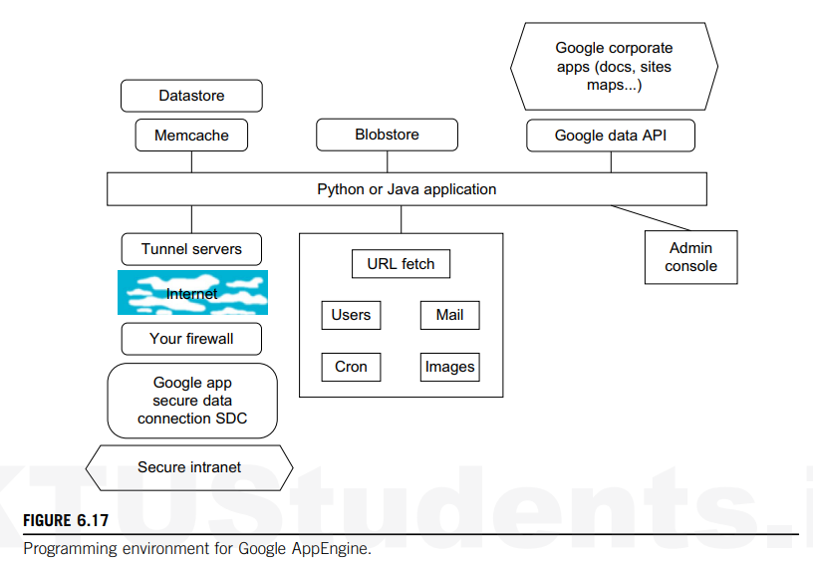

Slide 28
Datastore: A NoSQL database for storing and querying data.
Memcache: A distributed memory caching system to speed up dynamic web applications.
Secure Intranet: Ensures secure communication within the network.
Tunnel Servers: Used for secure data transmission.
Google Apps: Includes services like Docs, Sites, and Maps.
Blobstore: For storing large files.
Google Data API: Allows access to various Google services.
Cron: For scheduling tasks.
Images, Users, Mail, URL Fetch: Various services for handling images, user data, email, and fetching URLs.

Slide 29
Assignment
Google File System
BigTable
Google NOSQL

